Slide 1
Data Science Endeavors : Deep Feature Synthesis (DFS) “FERIHA”
Date : 21/06/2016
Automation of Data Science Application Pipeline
FERIHA: Feature Engineering Rich In Handling Automation
Notes:
In recent times, data science is the emerging field because of availability of data.
The pipeline to solve the data science is adhoc.
One of the most important part is to process the raw data and convert into valuable features.
This project is an initiative to automate that part in the data science pipeline.
feature engineering for relational and human behavioral
data remains iterative, human-intuition driven, and challenging,
and hence, time consuming.
any replacement for a human must be able
to engineer them acceptably well.

Slide 2
Agenda
Background & Motivation
Objective
System Overview
In Scope
Out of Scope
Technical Approach
Execution Approach
Working Model
Assumptions and Dependencies
Milestones
Acceptance Criteria
Risks
Glossary
References

Slide 3

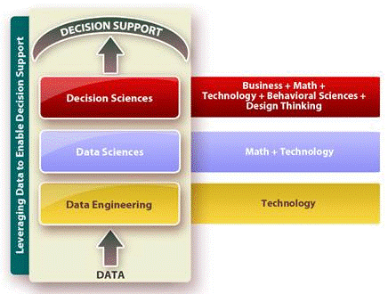
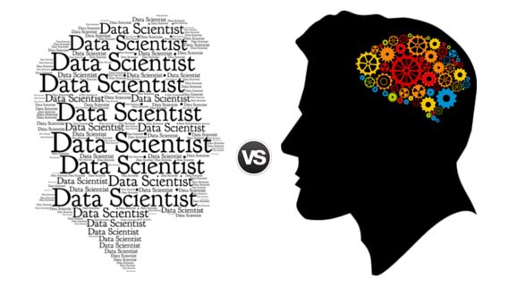
Background & Motivation
NTI’s INL main purpose is to:
“Automate the Data Science Application Pipeline”
Ref Paper: Deep Feature Synthesis: Towards Automating Data Science Endeavors
James Max Kanter, Kalyan Veeramachaneni [CSAIL, MIT Cambridge]
Creativity
Innovation
Data Science
Decision Science
25%
Being Unique has no value in itself , unless it gives the customer something of value
COPY+TRANSFORM+COMBINE
1% idea with 99% Execution
60%
15%
Data Driven
Knowledge Driven
Creativity
Innovation
Notes:
In recent times, data science is the emerging field because of availability of data.
The pipeline to solve the data science is adhoc.
One of the most important part is to process the raw data and convert into valuable features.
This project is an initiative to automate that part in the data science pipeline.
feature engineering for relational and human behavioral
data remains iterative, human-intuition driven, and challenging,
and hence, time consuming.
any replacement for a human must be able
to engineer them acceptably well.

Slide 4
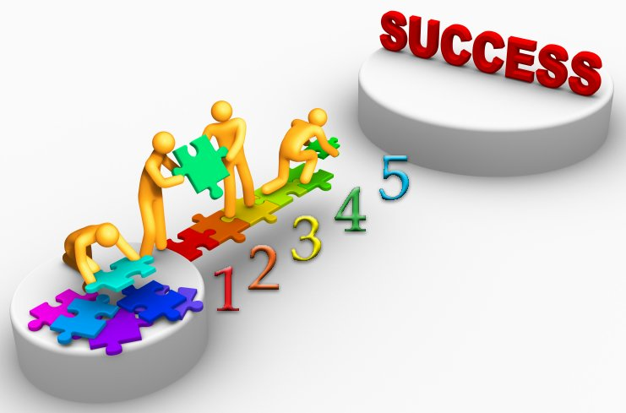
Objective
Objectives of NTIL “FERIHA” project are:
Domain Independent & Re-Usability
5.Automating Data Science for fast decision making skills (basic logic, intuitiveness ) of common man
4.Re-usable for any other predictive data science
problem(boost to the process with machine learning
in NTI on any multi-tabular, RDBMS)
3.Reduce Cost to improve the ROI (reduce the cost matrix)
1.Save on Time for (competitive with human solution) fast results.
2.Efficiently manage Resources to reduce efforts (shaping the data ) to have meaningful insights

Slide 5
System Overview
Data Science Process Flow: To Build Predictive Models
Data Ingestion & Cleaning
Feature Engineering & Query Generation
Predictive Modelling
Generate Model using ML for Prediction
Validation & Result Analysis
Analysis the predict results and deriving insights from data.
Tune Algorithmic Parameters
Feeding datasets into database: schema
Feature selection & generation
ETL Process: pre-processing
Data design
Predictive Model solving business problem
Input:
Relational Data with
Schema
Output: Query Tables to ML
15% 40% 25% 20%
Percentage of time require in each of the module
Simple manipulation to extract
maximum information out of data
Query generation to get sub selection
on the dataset

Slide 6
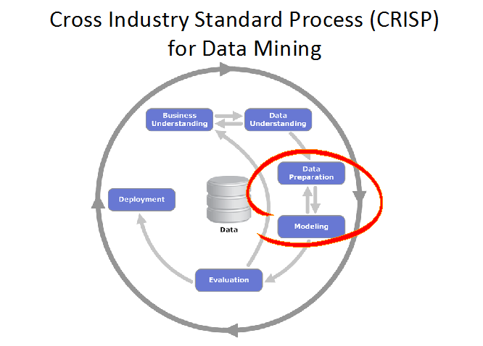
In Scope
Automating Feature Engineering & Query Generation Process
Crafting three types of Features via Deep Feature Synthesis
Algorithm (DFS):
EFEAT: Entity Features (establishing tabular relationships)
RFEAT: Relational Features (establishing backward relationships)
DFEAT: Direct Features ( establishing forward relationships)
Validation on different datasets
Select
Data Cleaning & Pre-Processing
Pre-process
Feature Engineering: Scaling,Decomposition,Aggregation
Transformation
Data Selection

Slide 7
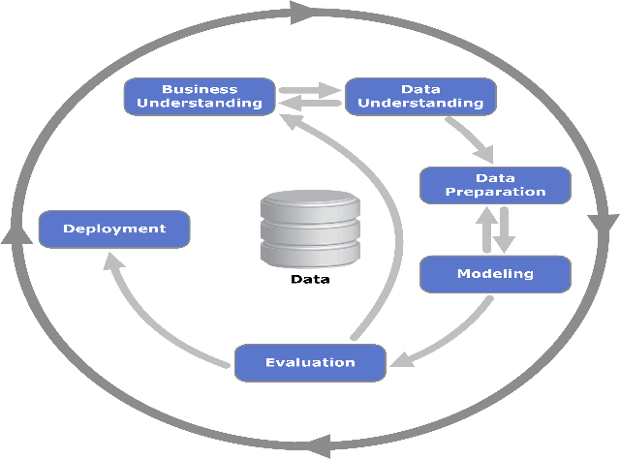
Out Of Scope
Algorithm used here only supports RDBMS structure
The system supports numerical data ( no text data)
The system supports multi tabular entities
Modelling can be done via machine learning separately
Tuning of model can be taken care by already built/different module
New algorithm development
Data creation /gathering – Wherever not available

Slide 8
Technical Approach
Analysis Report
Predictive Model
Synthesized Features
Single table containing features
SQL Queries to generate features
Preprocessed Raw Data(relational tables)
Prediction Model Generation
Feature Engineering
Result Analysis
Generate Insightful features to be used for modelling ( DSM Algorithm: EFEAT,DFEAT,RFEAT)
Prepare models using machine learning algorithm (Scikit-learn and other libraries )
Analyze the prediction results ( Param, Score)
Cleaning raw data and execute ETL Process (Python Utilities)
Data Storage and Cleaning
Store the data (MySQL)
Input: Raw Data
(Tabular Data/CSV Data)

Slide 9
Execution Approach
Project Start Date : 21/06/2016
Project End Date : 21/12/2016
Basic Specifications Document
High level Design
Implementation
And Testing
Proposal
Test Plan
2 Engineers, one week
2 Engineers, 1.5 Month
3 Engineers,
3 Months
3 Engineers,
1 Month
21/06/2016
13/06/2016
(Project Start
Date)
16/08/2016
19/09/2016
21/12/2016
(Project End Date)
27/06/2016
17/08/2016
21/09/2016

Slide 10
Working Model : DFS Algorithm Idea & Execution
Deep Feature Synthesis Deep Feature Synthesis
F1
F2
Fback
F1
F2
Ffwd
Backward relationships E_{B}
Forward
relationships E_{F}
RFEAT EFEAT DFEAT
Deep Feature Synthesis
Data Science Machine (Generate -> Tune - > Produce)
RFEAT: Backward Features
DFEAT: Forward Features
EFEAT: Entity Features

Slide 11
Example : Deep Feature Synthesis
ProductID | ProductCategory | Price
1 | Food | 20$
2 | Beverage | 15$
Product
Order Features | Product Features | Customer Features
CustomerID | Gender | Age
1 | Male | 23
2 | Female | 16
Customer
Given a prediction problem, the Data Scientist identifies the features in order to create one flat table. This takes 30-40% of complete data science pipeline to generate these features.
Objective is to automate this process to create one single table containing variables that can be used to build prediction models.
ID | OrderID | Product ID | Date
1 | 1 | 2 | 20102014
2 | 1 | 1 | 20102014
3 | 2 | 1 | 19102014
Order

Slide 12
Example :Deep Feature Synthesis (Feature Abstraction: EFEAT,DFEAT)
Entity Features and Direct Features
Entity Features
Entity Features are generated from the table . For e.g. Date feature is used to create calendar features
ID | Order ID | Day of Week | Is Weekend | Month | Year
1 | 1 | 6 | 0 | 11 | 2014
2 | 2 | 5 | 0 | 11 | 2014
ProductID | ProductCategory | Price
1 | Food | 20$
2 | Beverage | 15$
Direct Features
ID | OrderID | Product ID | Date
1 | 1 | 2 | 20102014
2 | 1 | 1 | 20102014
3 | 2 | 1 | 19102014
ID | Order ID | Product ID | Product Price | Product Category
1 | 1 | 2 | 15$ | Beverage
2 | 1 | 1 | 20$ | Food
Direct Features
Here each order is related to specific product. So we can generate direct features corresponding to each product contained in order table.

Slide 13
Deep Feature Synthesis (Feature Abstraction: RFEAT)
ID | Order ID | Day of Week | Is Weekend | Month | Year | Product ID | Product Price | Product Category
1 | 1 | 6 | 0 | 11 | 2014 | 2 | 15$ | Beverage
2 | 2 | 5 | 0 | 11 | 2014 | 1 | 20$ | Food
Table Containing features(Entity and Direct).Here Product and Order features are consolidated in one table
CustomerID | Gender | Age
1 | Male | 23
2 | Female | 16
Deep Feature d=1
Customer ID | Day of Week | Is Weekend | Month | Year | Customer Age | AVG(Orders.SUM(Product.Price)
Deep Feature d=2
AVG
SUM
MAX
MIN
STD
ID | Customer ID | Day of Week | Is Weekend | Month | Year | SUM(Product.Price)

Slide 14
Assumptions
ASSUMPTIONS
Final testing of the prototype will be performed within INL
The current system will contain the data of Kaggle competitions only.
Below testing methodology will be used in this project.
Unit Testing of Data Science application pipeline
Functional Testing of Data Science application pipeline: Positive and Negative scenarios
DEPENDENCIES
Request for data from Kaggle previous competitions to gather the whole data.
DSM is not useful for all types of data, and is a system implemented solely focusing on the exploitation of relational datasets.
It can be effective in relational datasets that do not conform to the previously-identified data science competition problem pattern

Slide 15
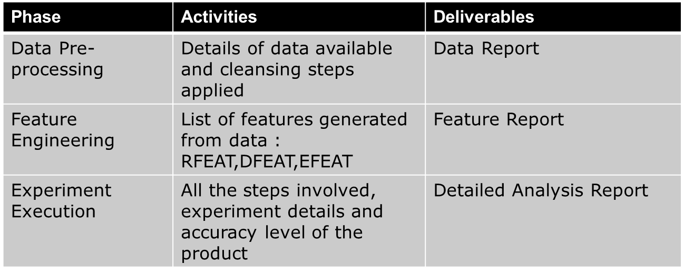
Milestones

Slide 16
Acceptance Criteria
Testing will de done for the released pipeline application and INL various other teams will provide the feedback. In case of any defect identified during acceptance testing the defects will be resolved.
In case of any minor comment (which takes less time and no need to change the design) NTI will incorporate the review comments.
In case of any major change (which takes more time and need to change the design), re-estimation will be performed.

Slide 17
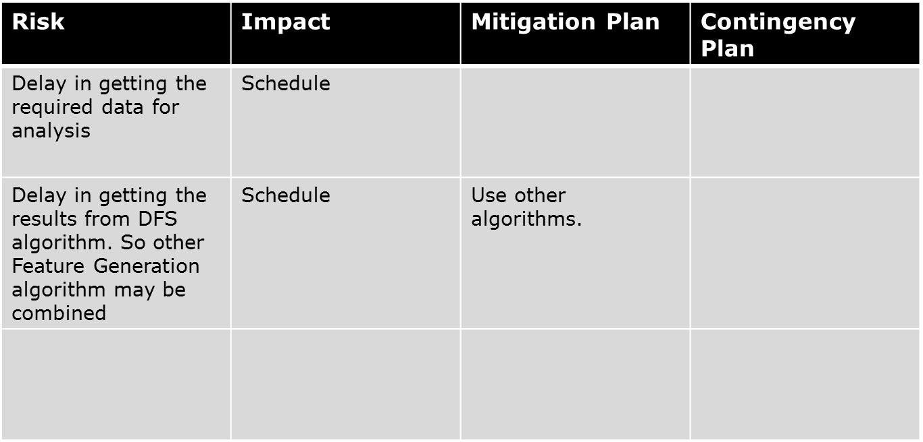
Risks

Slide 18
Glossary
DFS: Deep Feature Synthesis
DSE: Data Science Endeavours
GC: Gaussian Copula
RFEAT: Relational Features
EFEAT: Entity Features
DFEAT: Direct Features
ER: Entity Relationship
E_{B} : Backward Relationships
E_{F} : Forward Relationships

Slide 19
References :
Data Science Foundry for MOOCs : Sebastien Boyer, Ben U. Gelman, Benjamin Schreck, Kalyan Veeramachaneni. Accepted, IEEE/ACM Data Science and Advance Analytics Conference.
Transfer Learning for Predictive Models in Massive Open Online Courses : Sebastien Boyer, Kalyan Veeramachaneni. Accepted, 17th International Conference on Artificial Intelligence in Education.
Collaborative Embedding Features and Diversified Ensemble for E-Commerce Repeat Buyer Prediction Zhanpeng Fang∗ , Zhilin Yang∗ and Yutao Zhang
Repeat Buyer Prediction for E-Commerce Guimei Liu⋆ , Tam T. Nguyen⋆ , Gang Zhao#, Wei Zha⋆ , Jianbo Yang§ Jianneng Cao⋆ , Min Wu⋆ , Peilin Zhao⋆ , Wei Chen, Institute for Infocomm Research
Deep Feature Synthesis: Torwards Automating Data Science Endeavors : James Max Kanter, Kalyan Veeramachaneni. Accepted, IEEE/ACM Data Science and Advance Analytics Conference
The Data Science Machine is an end-to-end software system that is able to automatically develop predictive models
from relational data. The Machine was created by Max Kanter and Kalyan Verramachaneni at the Computer Science and
Artificial Intelligence Laboratory (CSAIL) at MIT.
https://www.csail.mit.edu/data_science_machine

Slide 20
NEC brings together and integrates technology and expertise to create
the ICT-enabled society of tomorrow.
We collaborate closely with partners and customers around the world,
orchestrating each project to ensure all its parts are fine-tuned to local needs.
Every day, our innovative solutions for society contribute to
greater safety, security, efficiency and equality, and enable people to live brighter lives.

Slide 22
PHASE 1 & PHASE 2: FERIHA
PHASE 1 & PHASE 2: FERIHA
Forward & Backward Features Analysis & Working with DSM Code.

Slide 23
Data Science Machine Code: Output
Company Database(2sec): Depth Level KDD2015 Database(10min 30 sec):
Employee (p.k)
Works_on(c.k)
Project(p.k)
Department(p.k)
Dept_locations(c.k)
Dependent(c.k)
Enrollment (p.k:Enrollment_id)
Log(p.k:Enrollment_id) (Source & Event)
Courses(p.k: course_id)
Users (p.k:users_id)
Object(p.k:course_id) (Category)
Level 0
Level 1
Level 2
Level 3
Level 4
# Rows: Employee(8)*
Works_on(16)*
Project(6)*
Department(3)*
Dept_Locations(5)
~11520
Dependent (7)
# Rows: Courses(39)*
Enrollments (120452)*
Users(74186)
~ 59172830808
Log(8157277)
Object(27249)

Slide 24
DSM code Flow: Steps
1.Enrollment: agg feature,one-to-one-feature,row features (p.k: enrollment_id)
(enrollment_id is the f.k) in Log; (log id : p.k) is independent & not in Source or Event table.
2. Log: agg feature,one-to-one-feature,row features and then Flat features
3.Enrollment: (p.k: enrollment_id) (username: f.k) with Users table: agg feature,one-to-one-
feature,row features and then Flat features
4. Enrollment (p.k: enrollment_id) (course_id:f.k) with Courses table :agg feature,one-to-one
feature,row features
5.Courses (p.k: course_id) with Object table (objects: f.k) :agg feature,one-to-one-feature,row
features and then Flat features and flat features
6. Courses: Flat features
7. Enrollment : Flat features.

Slide 25
Specifications of DSM code (1):
1. Primary key is not a constraint but advisable that in the schema tables should have non -integer (optional),candidate key(pair of columns) value of primary key. Primary Key, Foreign Key are never
considerd as numeric, unless stated in config file.
2. Primary key in terms of aggregate features is not used for using combination of ex: avg,min ;rather it will be used in grouping or segmenting w.r.t the column it is being referred to.
3.Row feature,1 -o -1 feature and aggregate feature from top to down: parent to child
flat feature (though its being computed twice but will be added from the dictionary to log files only when the path is bottom up and rest all other features are made.) all related features in the child table are done. At last it will make flat features for the parent table.
4. only upto level :2 depth of the BST( level from 0-2) the code will create features.
5. flat features will be stored in some other table( relative to making aggregate to some other table)
6. We will drop poly-features( cannot be used for analysis/optional w.r.t domain/null- features)
7. a max of 800 features would be generated ,out of the ones which are not used/generated/null values will be dropped in the final output.
8. In table.py : max_col_table = 500, where column dtype: float (0.8) and int(0.2)
9. The code restricts to creates 0-799 features (ex: User_1) while at later stage few will be dropped.
10. No features will be made for primary key.

Slide 26
Specifications of DSM code (2):
11. If there are less than equal to 2 distinct values in a column, it will be marked as categorical Otherwise, unless and untill stated explicitly in config file, it will not be categorical
12. If there are less than equal to 2 distinct values in a column, it will be marked as categorical. Otherwise, unless and untill stated explicitly in config file, it will not be categorical.
13. for maintaining globalColumnModificationDict & globalFeatureGenerationStatistics globalFeatureGenerationStatistics to have all information.
14. One-o-one feature creteria:
For deciding one_to_one mapping
a) If the number of rows of either of the table is >= 10000000 (10 million) then it will not be one_to_one
b) If after joining the 2 related tables, if group by primary key (related foreign key) is done, number of rows counted are all 1, then it is considered as one_to_one mapping
c) This check is cached in memory so that it can be used later on
d) one_to_one is checked in aggregate function as well, and also in one_to_one function, if caching has already been done, then cached data is used for taking decision

Slide 27
Specifications of DSM code (3):
15.Aggregate Features Creteria :
Backward Relationship Features -> func_type -> Count,Sum,Avg,Min,Max, Std
AggCount would be done on the basis number of rows after performing join operations based on foreign key relationship
AggSum/AggAvg/AggMin/AggMax/AggStd : will be executed only on columns which fall in the following category (i.e. their data type is of following class)
1) INTERGER 2) FLOAT 3) DECIMAL 4) DOUBLE 5) SMALLINT 6) MEDIUMINT
16.Direct Features Creteria :
Forward Relationship Features -> Flat features -> data from base table (where primary key is present) is copied to related table (where foreign key is)
17.Entity Features Creteria:
row_functions -> func_type -> Month,Weekday & TextLength
TextLength : To be applied to columns whos data type is TEXT only
Month/Weekday: To be applied to columns whos data type is DATETIME only

Slide 28
Specifications of DSM code (4):
18. Execution starts by iterating through the table given to last node based on dependent table,
\ParentTable
\_ChildTable
\_\_ChildTable
\_\_\_ChildTable (Last node)
then building features in following order
a) Aggregate Features b) Row Features c) one_to_one features (Eventually flat functions are applied for direct copy data) d) Flat features
After above, iteration starts on the basis parent tables starting from last node ChildTable (Last Node) \_parentTable <- Not part of iteration above
19. Final generated features are dumped to a file, (RAW DATA FILE) using dilli API, which will be read again in predict.py for testing generated features for relevance

Slide 29
Specifications of DSM code (5):
20. Valid config structure can be of following kinds (Refer on left side)
config = { <----------------- COMMON, will be present in all configs
"entities" : { <----------------- COMMON, will be present in all configs
"tablename1" : {
"feature_metadata" : { <----------------- COMMON, if a table exists, under this you will have the columns
"col1" : {
"categorical" : True/False
"numeric" : True/False
"categorical_filter" : True/False
"ignore" : True/False <----------------- If this column has to be ignored all together
}
},
"included_row_functions" : [], <----------------- If you want to explicitly include certain row functions
<----------------- for this table, valid entries would be
<-----------------
"excluded_row_functions" : [], <----------------- If you want to explicitly exclude certain row functions
<----------------- for this table, valid entries would be
"excluded_agg_entities" : ["sometablename"], <----------------- If you want to exclude some table during aggregation for this
<----------------- table
"one-to-one" : ["sometablename"], <----------------- If you want to explicitly state that another table is
<----------------- one-to-one mapped with this table. This means, if you do
<----------------- SELECT distinct(count(othertable.pkname)) FROM thistable JOIN
othertable ON othertable.pkname = thistable.fkname GROUP BY
thistable.pkname
<----------------- If all the values in above query turns out to be 1, then it is
<----------------- one-to-one
}
}
}

Slide 30
Specifications of DSM code (6):
21.

Slide 31
( Forward and Backward):DSM Model

Slide 32
Phase 1 & 2 ( DFEAT & RFEAT) Results (1):
1. This code can work with any well defined schema.
2. DFEAT : Forward features i,e Aggregate feature with COUNT function.
Ex: courses_1 :
{
1_total_columns_added : 22
Aggregate_Features : 22
courses_1__425 :
{
caller_table_name : Enrollments
current_table_name : courses
data_query : min(Enrollments.COUNT(Logs))
entity_function : Aggregate_Features
}
RFEAT : Backward features I,e Aggregate features with ( min,max,std,sum,avg) with/without COUNT function.
Ex: Enrollments_1 :
{
1_total_columns_added : 1
Aggregate_Features : 1
Enrollments_1__654 :
{
caller_table_name : no caller
current_table_name : Enrollments
data_query : COUNT(Logs)
entity_function : Aggregate_Features
}
}

Slide 33
Phase 1 & 2 ( DFEAT & RFEAT) Results (2) :
Also Flat features are part of backward features.
making flat features Enrollments
Ex: Adding Column in Table = Enrollments at column Number = 4 and data = course.from_date
3. Based on the code changes & debugging that we have done, we are in a position of generating statistics for complete schema as well as for individual tables.

Slide 34
ADDITIONAL SLIDES
ADDITIONAL SLIDES

Slide 35
HLD : Slides #1
Log Files
XML Files
CSV Files
Data Science Machine
INTERFACE
Database
Object Classification
Automated Feature Engineering Module
Machine Learning Model
Data Insights
Query
Module #2
Module #3
FERIHA : Module 2 Module 3

Slide 36
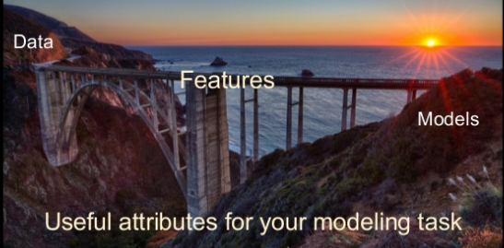
HLD : Slide #2 (Module #2: Feature Engineering)

Slide 37
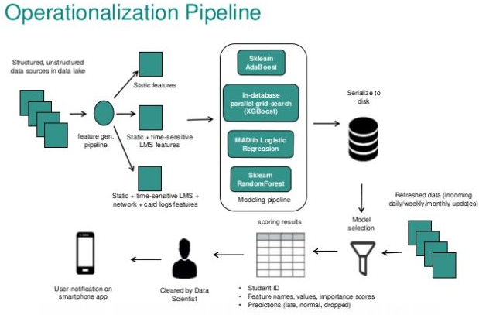

Slide 38
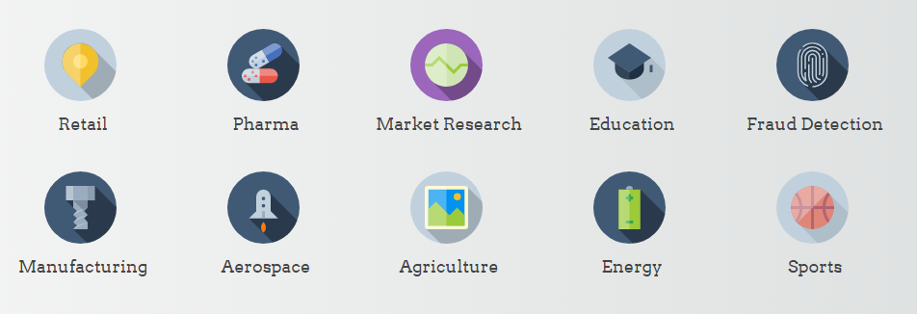
Benefits of data science automation
Solve What Matters Most: With data science automation, you can focus on what to solve rather than how to solve it.
Improve Data Science Accessibility :You'll increase involvement from product and domain experts in the data science process.
Scale Your Productivity: Cultivating your data science capabilities allows you to avoid tedious tasks and lets you focus on growth.
In order to successfully integrate data science into an organization, a platform that flexibly addresses the wide range of prediction problems encountered is needed. Many companies offer pre-built applications for specific data science use cases. However, data doesn't appear the same between organizations, hindering the path to implementation. FERIHA has proven itself across a variety of industries as a robust data science solution for your organization.

Slide 39
Innovative companies use their data to stay ahead of the competition. Predictive modeling with Feature Labs enables developers, analysts, managers, and executives to build and deliver intelligent products tailored to their unique needs.
Solving business problems with "Prediction Engineering“ :FERIHA offers a flexible interface to define and predict any future "event" of interest to an organization
Automated Feature Engineering: This enables users to obtain the accuracy levels of human data scientists in 1/10th of the time.
Easy Model Deployment :Data on its own doesn’t do much; it must be used and used well. And to do it effortlessly. It's easy to retrain using new data, to adjust modeling parameters,

Slide 40
Featured composition :Kanter and Veeramachaneni use a couple of tricks to manufacture candidate features for data analyses. One is to exploit structural relationships inherent in database design. Databases typically store different types of data in different tables, indicating the correlations between them using numerical identifiers. The Data Science Machine tracks these correlations, using them as a cue to feature construction. Example :one table might list retail items and their costs; another might list items included in individual customers’ purchases. The Data Science Machine would begin by importing costs from the first table into the second. Then, taking its cue from the association of several different items in the second table with the same purchase number, it would execute a suite of operations to generate candidate features: total cost per order, average cost per order, minimum cost per order, and so on. As numerical identifiers proliferate across tables, the Data Science Machine layers operations on top of each other, finding minima of averages, averages of sums, and so on.
It also looks for so-called categorical data, which appear to be restricted to a limited range of values, such as days of the week or brand names. It then generates further feature candidates by dividing up existing features across categories.
Once it’s produced an array of candidates, it reduces their number by identifying those whose values seem to be correlated. Then it starts testing its reduced set of features on sample data, recombining them in different ways to optimize the accuracy of the predictions they yield.
“The Data Science Machine is one of those unbelievable projects where applying cutting-edge research to solve practical problems opens an entirely new way of looking at the problem,” says Margo Seltzer, a professor of computer science at Harvard University who was not involved in the work. “I think what they’ve done is going to become the standard quickly — very quickly.”

Slide 41
Business Goals : FERIHA
Translate the business need to problem prediction: The process of deciding what to predict -- or “Prediction Engineering” -- is the most significant factor in data science expectations. Companies frequently build predictive models that cannot be operationalized for the use case they were designed to address. The Question should be : “How will a prediction be used?”
Experiment with new predictive models: Prediction Engineering frequently uncovers many approaches to address a business’ needs. You should pick one to get underway, but you will find down the road that other ideas have value. The key to extracting the most from your data is to find untapped opportunities first rather than fine-tuning every last improvement in an existing model.
Get the right people involved in the process: Placing tools into the hands of the right people makes a significant difference in the return on investment from data science investments. So that they can built predictive models can solve real business problems using new technology -- and do it both simply and efficiently.

Slide 46
Automation of DATA SCIENCE : FERIHA (Name of our Product)
“FERIHA” would be name for our product
FERIHA ( Feriha originates in Turkish language and it means "joyous woman" ) i,e
Also F: Feature
E: Engineering
R: Rich
I : In
H: Hammurabi/Handling
A: Automation
here “Hammurabi " means a builder has more knowledge than the inspector
Why was Hammurabi important to history?
The importance of Hammurabi and his Code of Laws is that he was not the first monarch to make such laws
but that he was the first to record them for his people and prosperity. This is a worthy legacy indeed. The l
after years of Hammurabi's reign were spent in almost constant warfare.

Slide 47
Kdd2015 Vs Company : Database
Database | Table | #Row | # Feature | #Aggregate : sum,avg,min,max,std (RFEAT) Backward | #Flat feature (RFEAT) Backward | # Row, 1-o-1, Aggregate (count): DFEAT Forward |  | # Drop features
Kdd2015 | Enrollments | 120452
Kdd2015 | Users | 79186
Kdd2015 | Courses | 39
Kdd2015 | Log | 8157277
Kdd2015 | Object | 27249
Kdd2015 | Event, Source, Category | 7,2,15
Company | employee | 8
Company | works_on | 16
Company | project | 6
Company | department | 3
Company | dept_locations | 5
Company | dependent | 7

Slide 48
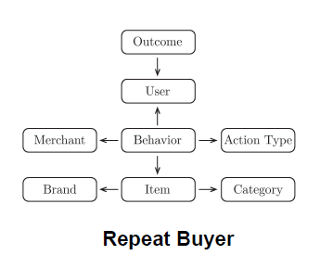
Data Science Machine : Problem description
Project Excitement (KDD 2014)
Using past projects' histories on DonorsChoose.org, predict if a crowd-funded project is "exciting".
Repeat Buyer Prediction (IJCAI 2015)
Using past merchant and customer shopping data, predict if a customer making a purchase with a promotion will turn into a repeat buyer (1.9 GB)
Student Dropout (KDD 2015)
Using student interaction with resources on an online course, predict if they will dropout in next 10 days.
“The Data Science Machine can enable non-data scientists to build predictive models”

Slide 49
Project (Automating Data Science) : Plan Schedule
Task/Activities in hand | Planned Start Date | Planned End Date | Actual Start Date | Actual End Date | Remarks
Activity Understanding/Literature Survey/Basic Plot discussion & Planning Scope of Proposal | 1 June 2016 | 17 June 2016
Gathering requirements/Data Understanding/Tools description/Modular Approach :Automating Feature Engineering (Module 2)
Creating Database: inserting dataset, schema building, subset of dataset selection for training purpose
Designing : ER relationship, storing in data structure, graphical network format, query generation etc.)
Feature selection (EFEAT,DFEAT,RFEAT): Familiarity with python libraries
Feature Generation (EFEAT,DFEAT,RFEAT): coding and testing w.r.t the algorithm selection(DFS)
Setting up the predictive modelling pipeline (real dataset) : test purpose
Testing & implementing (Predictive model generation):Validation of model + Tuning of parameters/model

Slide 50
Deep Feature Synthesis (Feature Abstraction: RFEAT)
RFEAT :Relational Features:1.Two entities
2. Aggregate rows &
apply functions
3. Backward Relationships
4. Ex: count,mean,
no. distinct,std
5. Condition on
categorical features
Logs
CustomerID
Date
EventType
ProductID
Orders
OrderID
CustomerID
Date
Customers
CustomerID
Gender
Age
Churned
Products
ProductID
ProductCategory
Merchant
Price
OrderProduct
OrderID
ProductID

Slide 51
Deep Feature Synthesis (Feature Abstraction: DFEAT)
DFEAT : Direct Features: 1.Direct reflection
2.Two entities
3.Forward Relationships
4. Ex: reflect, metadata
Logs
CustomerID
Date
EventType
ProductID
Orders
OrderID
CustomerID
Date
Customers
CustomerID
Gender
Age
Churned
Products
ProductID
ProductCategory
Merchant
Price
OrderProduct
OrderID
ProductID
Price

Slide 52
Deep Feature Synthesis (Feature Abstraction: EFEAT)
EFEAT :Entity Features: 1.One entity,
2.Single row :weekdays
ratios, differences
3.Multiple row: derivatives,
bag of words
Logs
CustomerID
Date
EventType
ProductID
Orders
OrderID
CustomerID
Date
Customers
CustomerID
Gender
Age
Churned
Products
ProductID
ProductCategory
Merchant
Price
OrderProduct
OrderID
ProductID

Slide 53
Execution Approach
Project Start Date : 21/06/2016
Project End Date : 21/12/2016
Basic Specifications Document
High level Design
Implementation
And Testing
Proposal
Test Plan
2 Engineers, one week
2 Engineers, 1.5 Month
3 Engineers,
3 Months
3 Engineers,
1 Month
21/06/2016
13/06/2016
(Project Start
Date)
16/08/2016
19/09/2016
21/12/2016
(Project End Date)
27/06/2016
17/08/2016
21/09/2016

Slide 54
Good features allow a simple model to beat a complex model.
http://radar.oreilly.com/2014/06/streamlining-feature-engineering.html
Data Mining using the Weka toolkit: https://notendur.hi.is//~benedikt/Courses/DataMining7.htm
2. Coppersmith is a library to enable the joining, aggregation, and synthesis of "features", streams of facts about entities derived from "analytical records":https://github.com/CommBank/coppersmith & https://github.com/CommBank/coppersmith/blob/master/USERGUIDE.markdown
3. Discover Feature Engineering, How to Engineer Features and How to Get Good at It: http://machinelearningmastery.com/discover-feature-engineering-how-to-engineer-features-and-how-to-get-good-at-it/
4. dato-code/userguide : https://github.com/dato-code/userguide/tree/master/feature-engineering
5. ERD plus : https://erdplus.com/#/
6. Feature Engineering : http://www.analyticsvidhya.com/blog/2016/01/guide-data-exploration/#four &&& http://www.analyticsvidhya.com/blog/2013/11/simple-manipulations-extract-data/
7. Feature Engineering or the Creation of New Features
A simple example to keep in mind is text mining. One starts with raw text (documents) and extracted features could be individual words or phrases. In this setting, a feature could indicate the frequency of a specific word or phrase. Features1 are then used to classify and cluster documents, or extract topics associated with the raw text. The process usually involves the creation2 of new features (feature engineering) and identifying the most essential ones (feature selection).
http://radar.oreilly.com/2014/06/streamlining-feature-engineering.html (IMP)

Slide 55
http://radar.oreilly.com/2013/09/data-analysis-just-one-component-of-the-data-science-workflow.html
https://scn.sap.com/community/predictive-analytics/blog/2015/09/28/feature-engineering-tips-for-data-scientists

